Slide 1

Sentimental Analysis of Acoustic Waves -Dr. B Sankara Babu
GOKARAJU RANGARAJU INSTITUTE OF ENGINEERING AND TECHNOLOGY
Department of Computer Science and Engineering
MINI Project Review-3
Nikhil chitte- 20241A05P3
P.Shravan kumar- 21245A0527
Nirupam Satvik- 20241A05Q2
Danush- 20241A05P5

Slide 2
ABSTRACT: Sentiment analysis of acoustic waves is a crucial aspect of modern audio processing, aimed at understand categorizing emotions conveyed through audio signals. This project focuses on developing a comprehensive solution for sentiment analysis of acoustic waves using machine learning algorithms. The methodology involves extracting meaningful features from audio signals, and feeding them into classifiers such as Support Vector Machines (SVMs) and Artificial Neural Networks (ANNs) for sentiment prediction. The performance of these algorithms is evaluated on a large and diverse dataset of acoustic waves, and their results are compare and analysed to determine the most effective model. The results of this project are expected to provide new insights into the field of sentiment analysis, and pave the way for future research in the area of audio processing and emotional recognition.
GOKARAJU RANGARAJU INSTITUTE OF ENGINEERING AND TECHNOLOGY
Department of Computer Science and Engineering
MINI Project Review-3

Slide 3
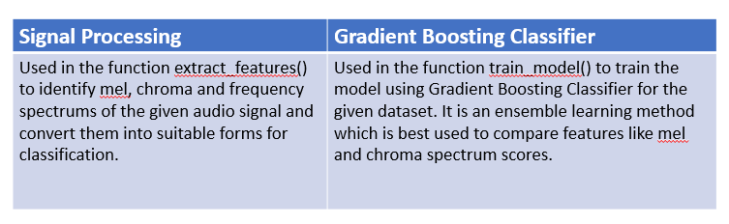
Algorithm Used in the project

Slide 4
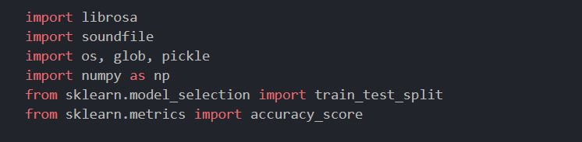
Project Implementation & Execution (100%)
GOKARAJU RANGARAJU INSTITUTE OF ENGINEERING AND TECHNOLOGY
Department of Computer Science and Engineering
MINI Project Review-2

Slide 5
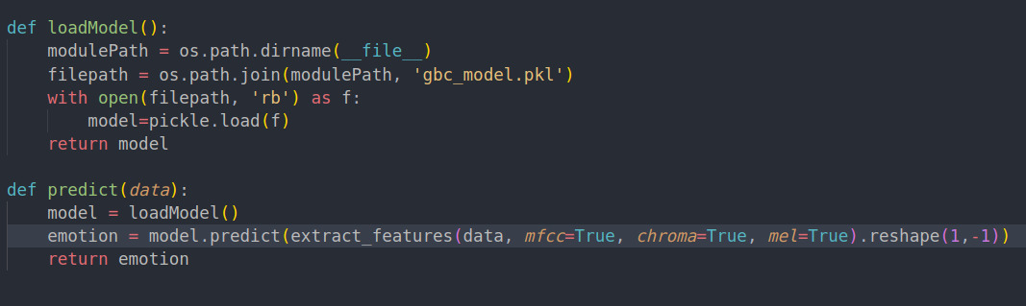
Project Implementation & Execution
GOKARAJU RANGARAJU INSTITUTE OF ENGINEERING AND TECHNOLOGY
Department of Computer Science and Engineering
MINI Project Review-2

Slide 6
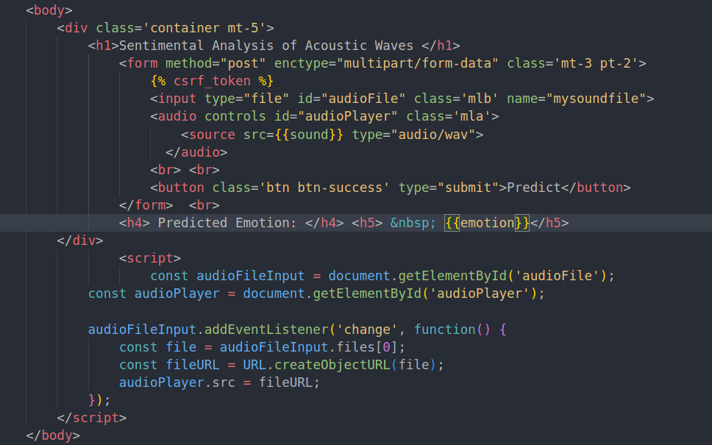
Project Implementation & Execution
GOKARAJU RANGARAJU INSTITUTE OF ENGINEERING AND TECHNOLOGY
Department of Computer Science and Engineering
MINI Project Review-2

Slide 7
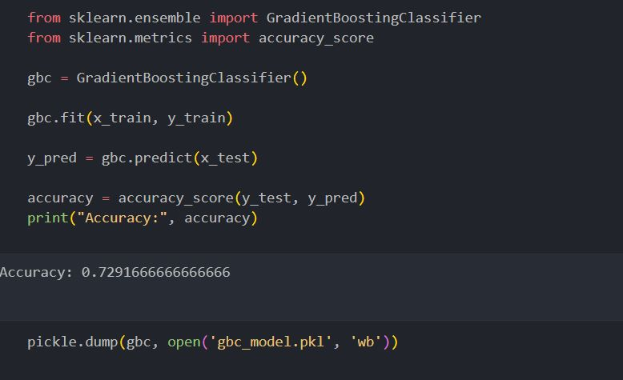
Project Implementation & Execution (100%)
GOKARAJU RANGARAJU INSTITUTE OF ENGINEERING AND TECHNOLOGY
Department of Computer Science and Engineering
MINI Project Review-2

Slide 8
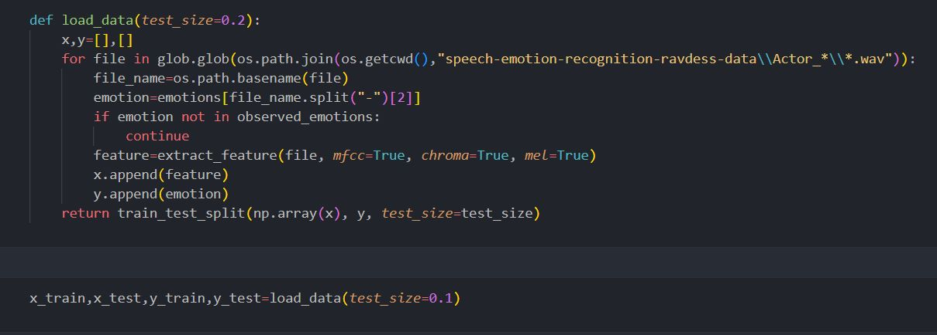
Project Implementation & Execution (100%)
GOKARAJU RANGARAJU INSTITUTE OF ENGINEERING AND TECHNOLOGY
Department of Computer Science and Engineering
MINI Project Review-2

Slide 9
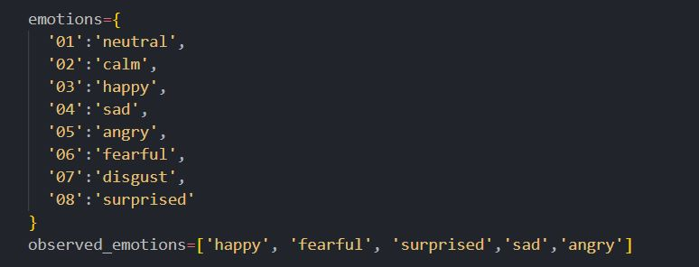
Project Implementation & Execution (100%)
GOKARAJU RANGARAJU INSTITUTE OF ENGINEERING AND TECHNOLOGY
Department of Computer Science and Engineering
MINI Project Review-2

Slide 10
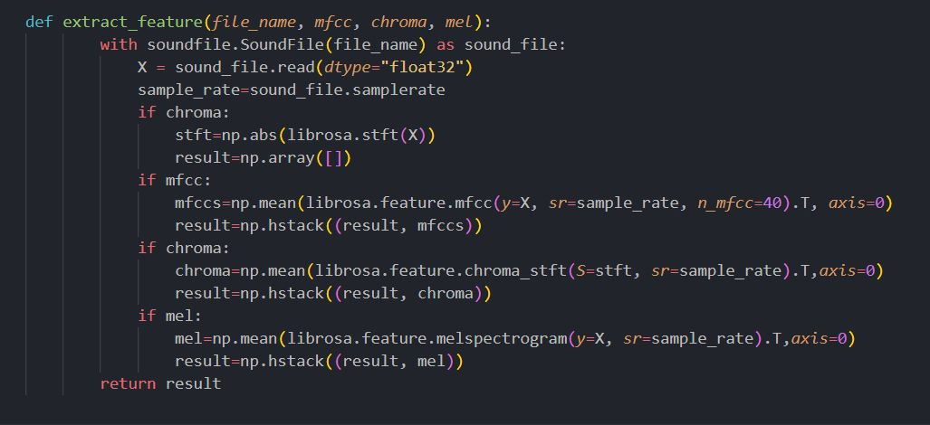
Project Implementation & Execution (100%)
GOKARAJU RANGARAJU INSTITUTE OF ENGINEERING AND TECHNOLOGY
Department of Computer Science and Engineering
MINI Project Review-2

Slide 11
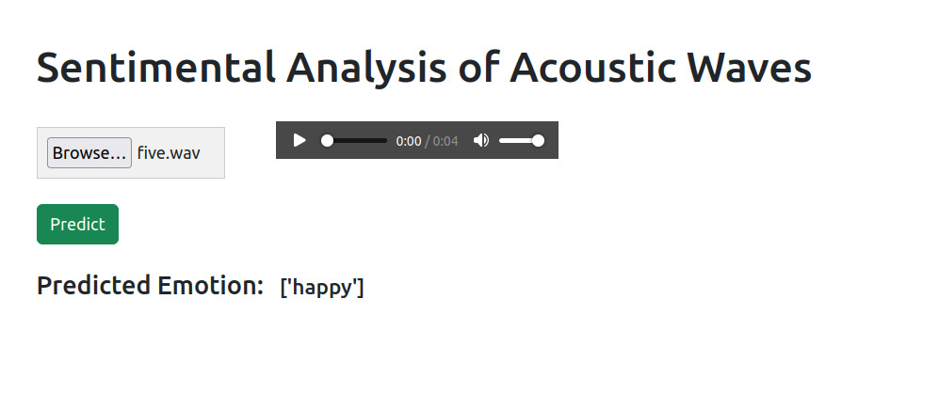
Results:

Slide 12
Conclusion & Further Scope:
Many speech emotion detectors require language specific training for getting accurate results. It is because there are many types of languages spoken, different emphasis on different words and different accents for the same language.
Emotion detectors such as this one requires no language specific training as it solely relies on the wave characteristics and can easily determine the intent of the speaker.
There is room for improvement because we used the length of the wave to be 2 because of limited computational power, but if used in environments with good computational power, we can achieve better understanding with good depth of the waves.
We plan to increase the size of the audio files it can predict because as of now we can only predict emotions from files with less than 4 seconds.
We can enhance the project and use it in many cases like gaming, military, and other places where privacy of the data is important and the intent of the speaker is to be known.
This project can also help detect bullies in public places without even storing the audio which saves us a lot of space.

Slide 13
Thank You ANY Queries Please?
GOKARAJU RANGARAJU INSTITUTE OF ENGINEERING AND TECHNOLOGY
Department of Computer Science and Engineering
MINI Project Review-2

